Slide 1
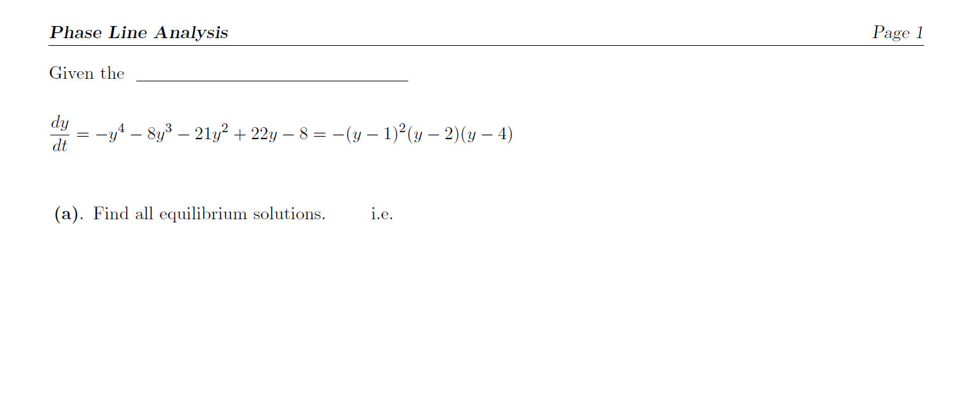

autonomous 1st oder ODE
$$\frac{dy}{dt}=0$$
$$−{\left(y−1\right)}^{2}\left(y−2\right)\left(y−4\right)=0$$
$$y=1, 2, 4$$

Slide 2
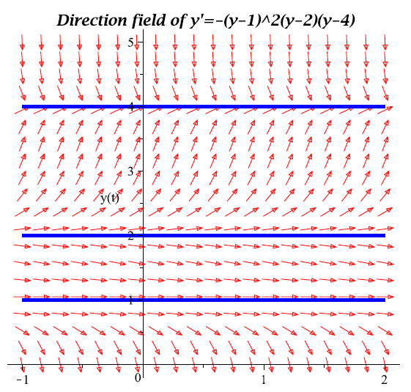
(i.e., Asymptotic Behavior)
If $y_{0}=3$, then $y→4$ as $t→∞$
If $y_{0}>4$, then $y→4$ as $t→∞$
If $2<y_{0}<4$, then $y→4$ as $t→∞$
If $1<y_{0}<2$, then $y→1$ as $t→∞$
If $y_{0}<1$, then $y→−∞$ as $t→∞$

Slide 3
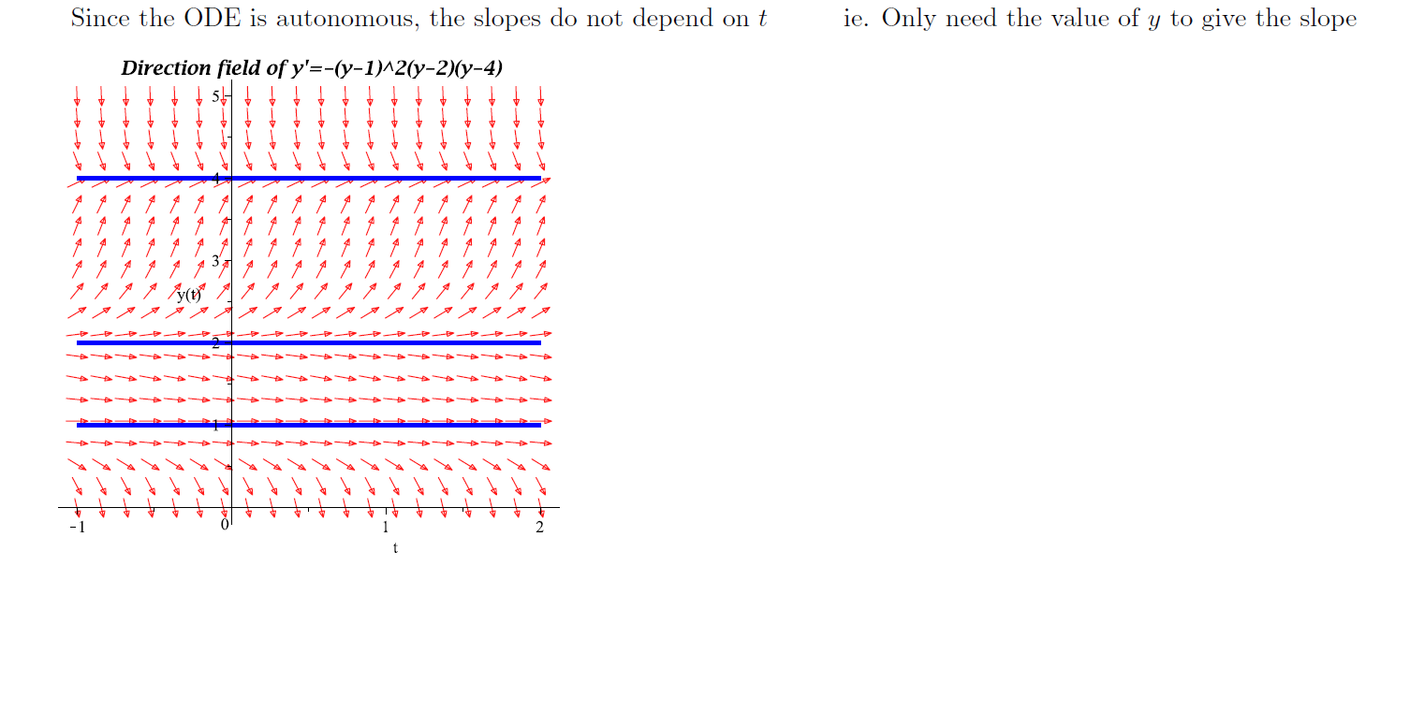
y
y
Slope $\frac{dy}{dt}<0 →y$ decreases
4
4
Slope $\frac{dy}{dt}>0 →y$ increases
2
2
Slope $\frac{dy}{dt}<0 →y$ decreases
1
y
1
Slope $\frac{dy}{dt}<0 →y$ decreases
Doesn’t depend on t, only need y
4
Phase Line contains the relevant information
Phase Line usually drawn horizontally
2
1

Slide 4
Asymptotic
л
Solid Circle
Stable (sink)
$$y=4$$
Unstable (source)
$$y=2$$
Open Circle
Semistable (node)
$$y=1$$
[Technically unstable]
[See Board]

