Slide 1
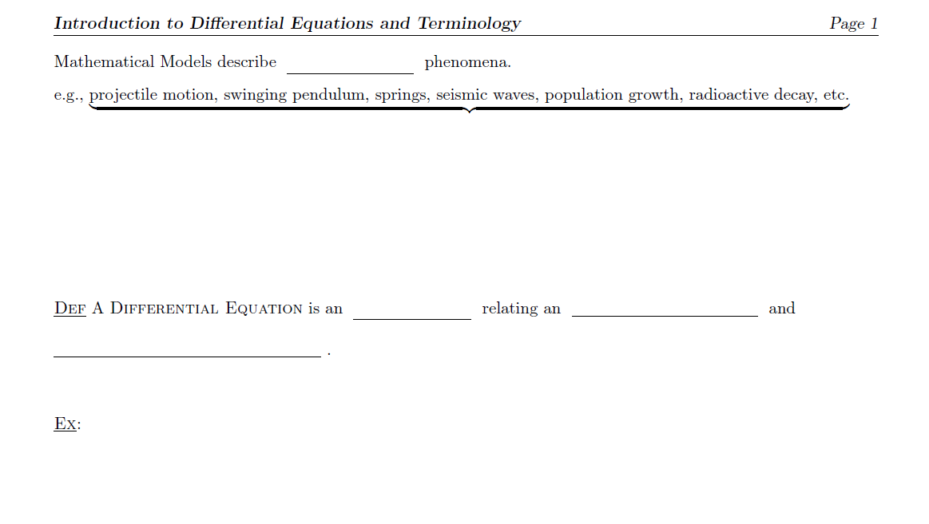
(physical)
changing quantities
Use DERIVATIVES
since they represent rates of change
equation
unknown function
one or more of its derivatives
$$\frac{dx}{dt}=x^{2}+t^{2}$$
$x\left(t\right)$ is the unknown function (related to it’s first derivative)
$$y^{′′}+2y^{′}+y=\cos{t}$$
$y(t)$ is the unknown function (related to $y^{′}\text{and} y′′$)

Slide 2
$$\frac{d^{2}h}{dt^{2}}=h′′(t)$$
(see board)

Slide 3
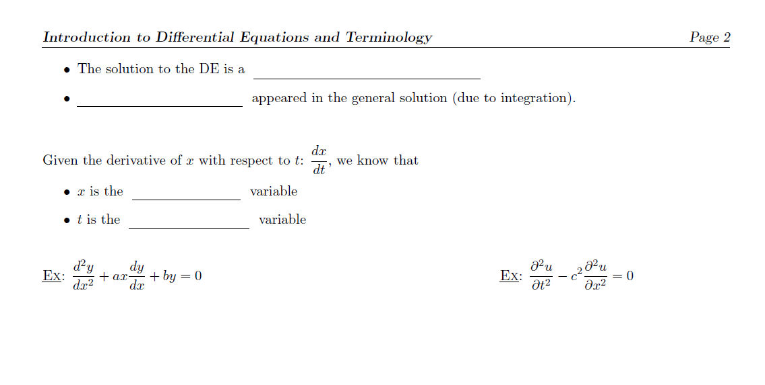
function ( $h\left(t\right), y\left(x\right)$, etc. )
Arbitrary constants
But will also appear even when we learn other techniques for solving DEs.
dependent
independent
Dep. Var.: y
Constants: a, b
Dep. Var.: u
Constants: c
Indep. Var.: x
Solution: y(x)
Indep. Var.: x, t
Solution: u(x, t)

Slide 4
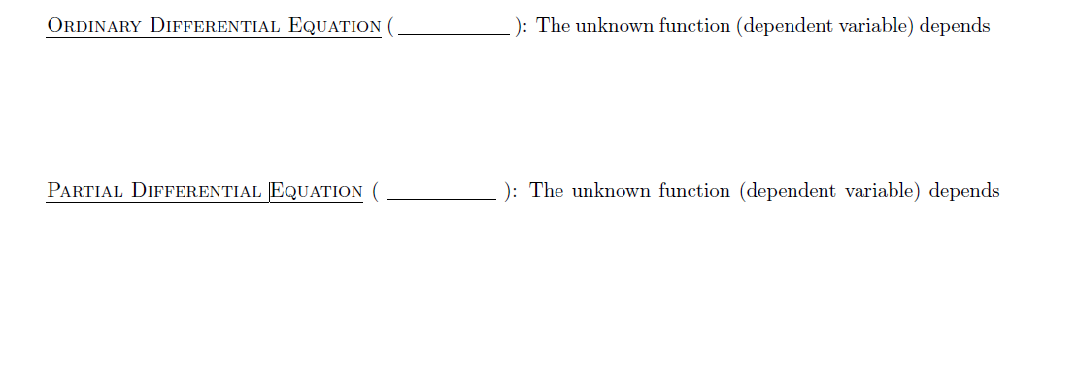
ODE
on only one independent variable.
Hence only ordinary derivatives ($\frac{dy}{dx}, \frac{d^{2}y}{dx^{2}}, \frac{dx}{dt}$, etc.) appear in the equation.
PDE
on more than one independent variable.
Hence partial derivatives ($\frac{∂u}{∂x}, \frac{∂^{2}u}{∂x^{2}},\frac{∂u}{∂t}$, etc.) appear in the equation.

Slide 5
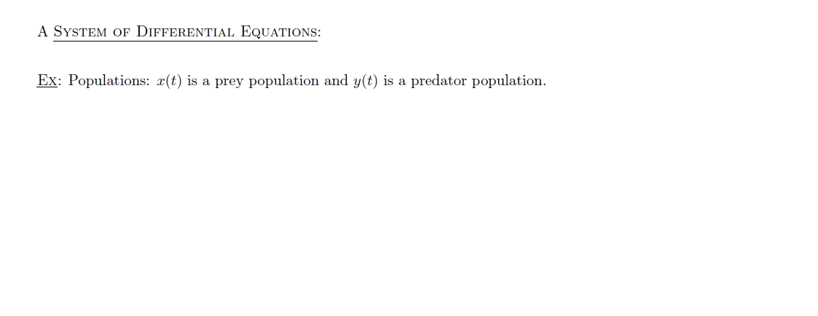

DE’s for 2 or more unknown functions.
$$\frac{dx}{dt}=ax − α xy$$
$$\frac{dy}{dt}=−cy+ γ xy$$
System has the solution
x = x(t)
y = y(t)

Slide 6
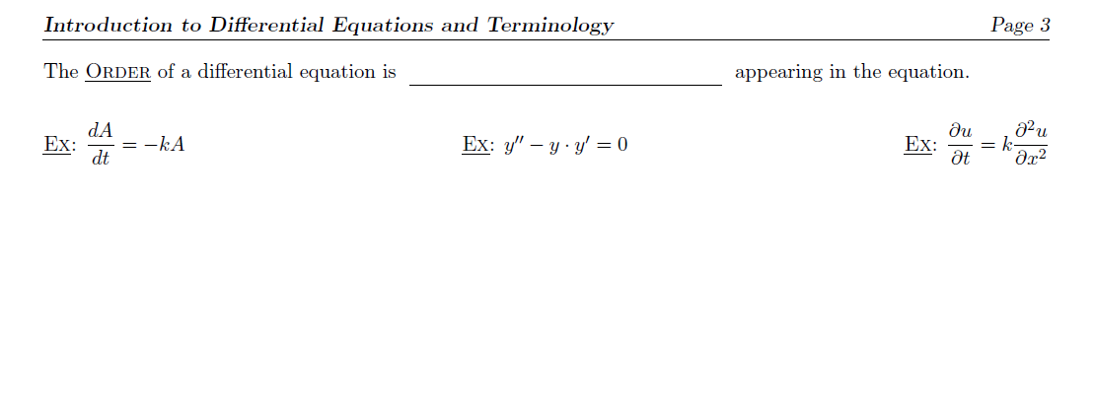
the highest order derivative
1st order
2nd order
2nd order
(Radioactive Decay)
(Heat Equation)

Slide 7
up to its n^{th} derivative y^{(n)}
$$F\left(t, y, y^{′},y^{′′},y^{′′′},y^{\left(iv\right)}\right)=0$$
$$y^{(iv)}=−3 sin\left(t\right){ y}^{′′}−y$$

Slide 8
$$ax^{2}+{by}^{2}=1$$
$$x+y=xy$$
the dependent variable (e.g., y) and its derivatives appear linearly.
The dependent variable y appears linearly.
Linear
Nonlinear
Linear
It doesn’t matter how the independent variable x appears.

Slide 9
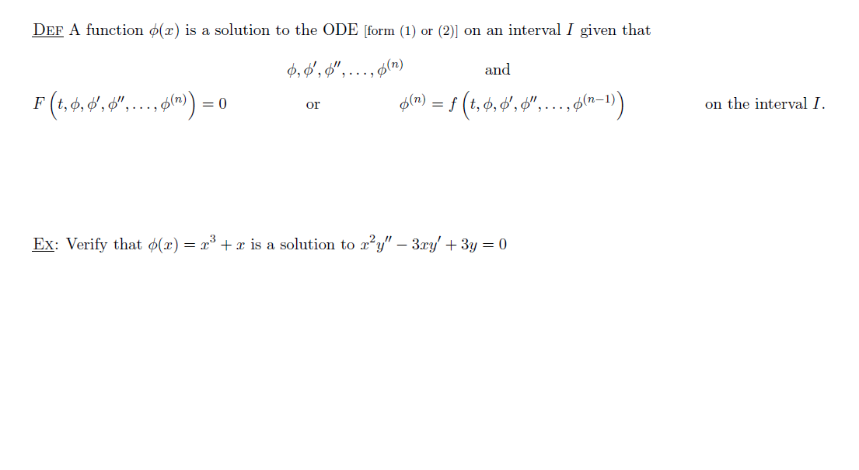
exist
satisfy
i.e., To be a solution:
The function and all derivatives up to and including the n^{th} derivative must exist.
and
When they are substituted into the ODE, you get a true statement.
(see board)
Substitute $y= φ\left(x\right)$ into the equation

