Slide 1
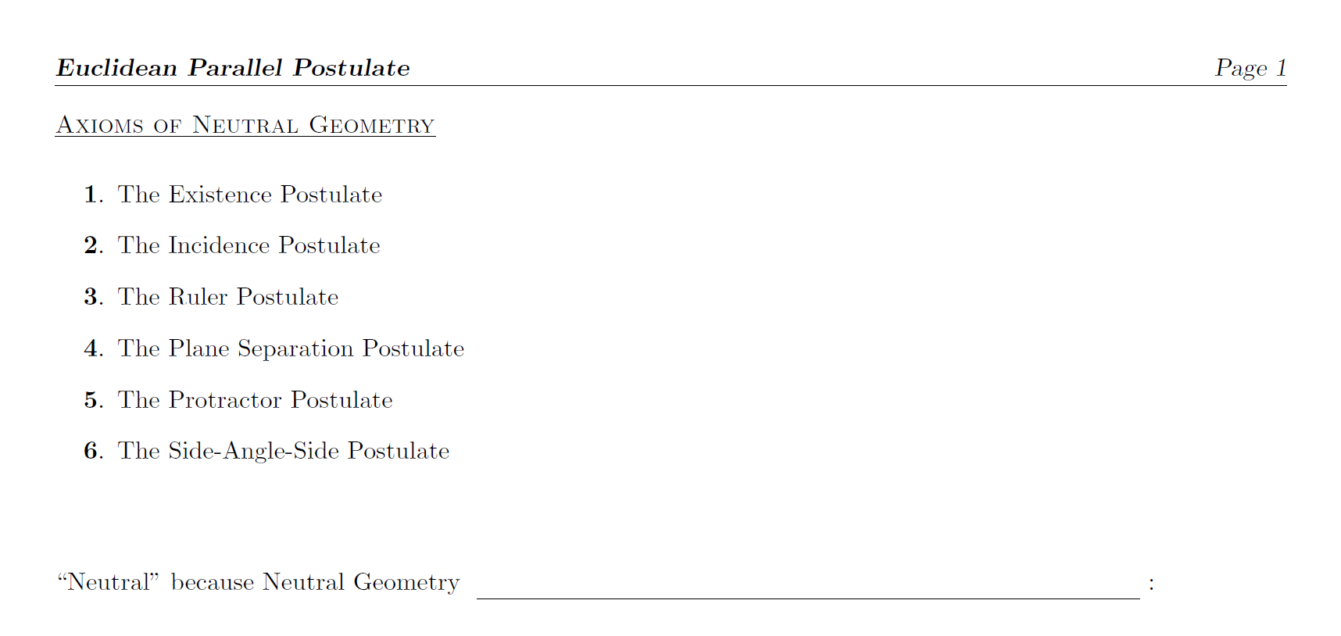
doesn’t take a stand on the PARALLEL POSTULATES

Slide 2
6 Axioms
+
Euclidean PP
6 Axioms
+
Hyperbolic PP
6 Axioms
+
Elliptic PP
Ex Spherical Geometry
Fails to satisfy:
2. Incidence
3. Ruler
Euclidean
Geometry
Hyperbolic
Geometry
Inconsistent w/
Neutral Geometry
Elliptic Geometries
are NOT Neutral Geometry

Slide 3
6 Axioms
+
Euclidean PP
6 Axioms
+
Hyperbolic PP
Is it possible to mix Euclidean and Hyperbolic Geometries?
i.e., Within the same geometry can you have some lines and external points that have a unique parallel line and for other lines and external points with multiple parallel lines?
Euclidean
Geometry
Hyperbolic
Geometry
No!

Slide 4
every
every
at least two lines
Proof (later, maybe)
negation
Neutral Geometry

Slide 5
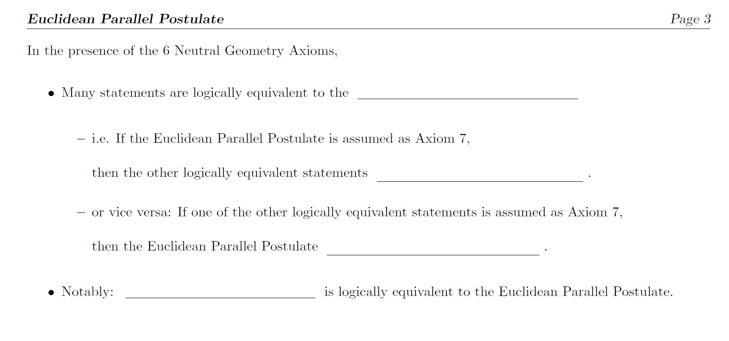
Euclidean Parallel Postulate
can be proved as theorems
can be proved as a theorem
Euclid’s Fifth Postulate

Slide 6
t
l
A
A’
l’
μ(<A) + μ(<A’) < 180
If l and l ’ are two lines cut by a transversal t in such a way that the sum of the measures
of the two interior angles on one side of t is less than 180, then l and l ’ intersect on that
side of t.

