Slide 1
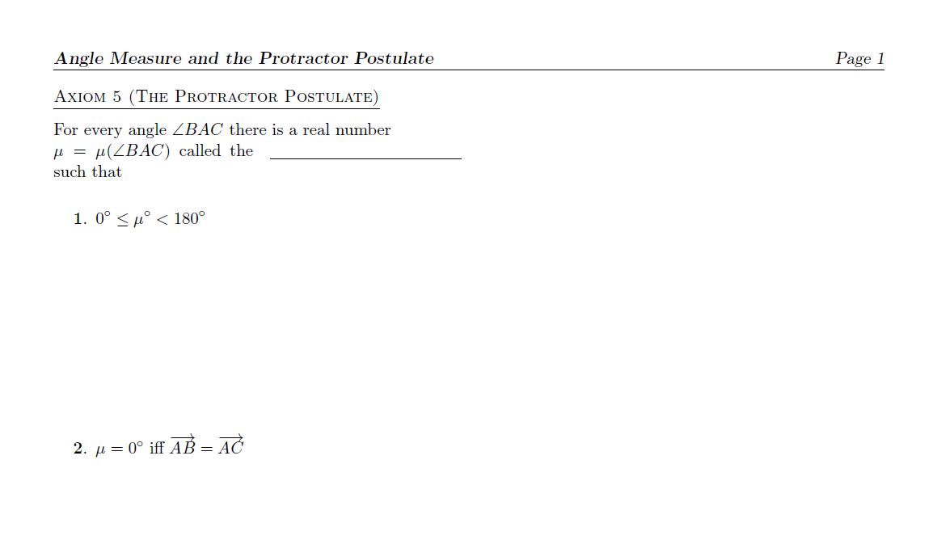
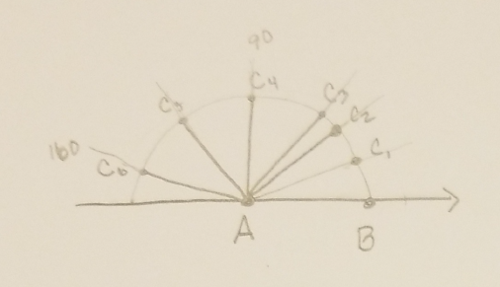
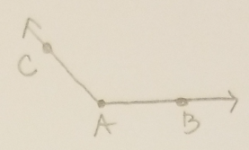
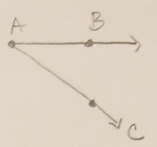
i.e. There is a one-to-one correspondence between angles and real numbers in the interval [0, 180).
measure of <BAC
Still positive
One-to-one correspondence w/pts on the semicircle and [0,180)
[Conceptually similar to the Ruler Postulate]

Slide 2
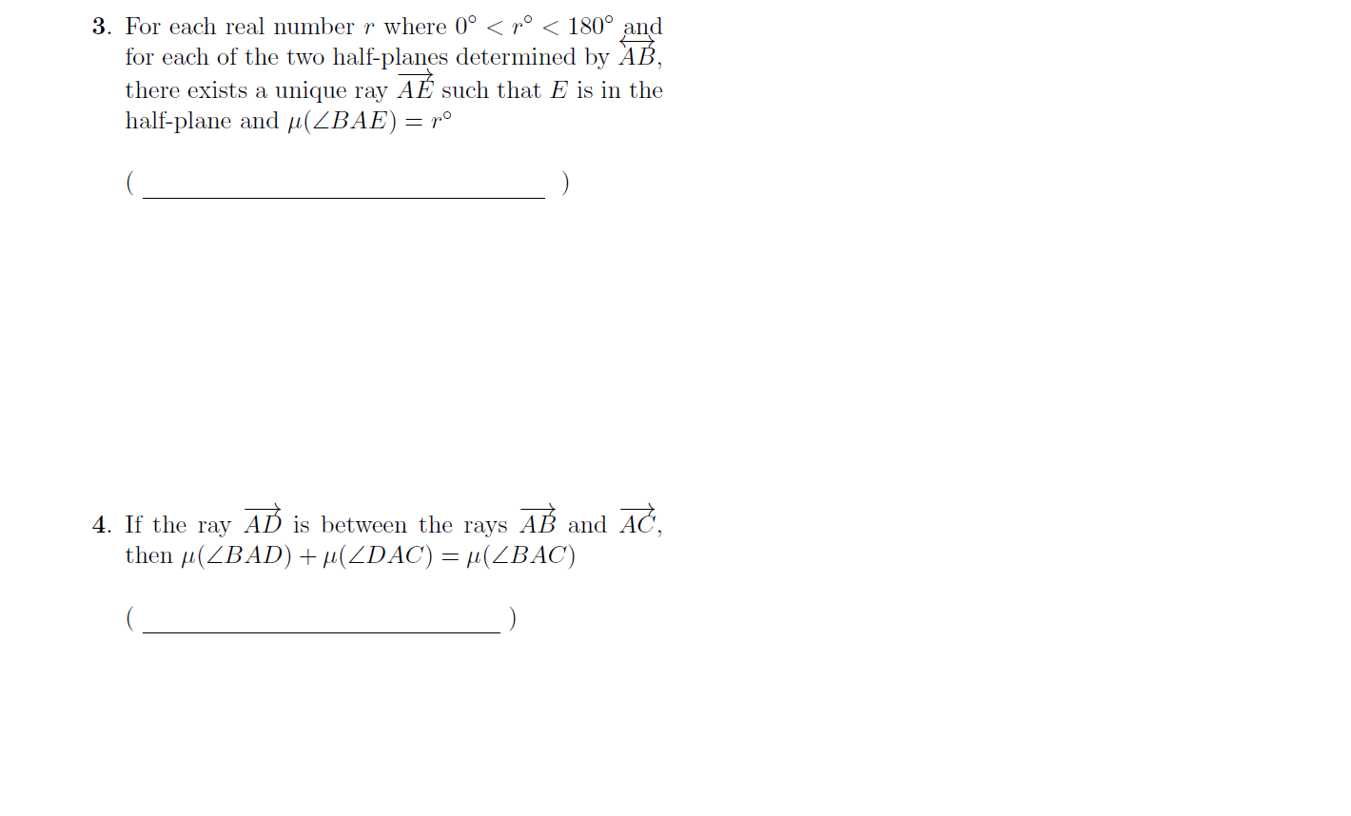
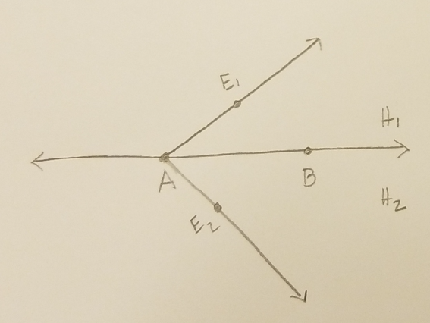
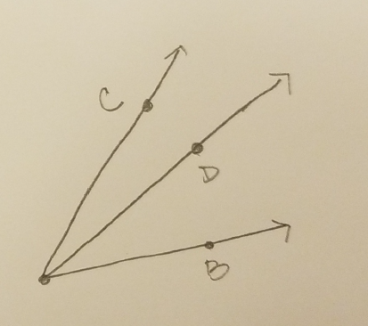
r
Angle-Construction Postulate
Ray is unique (in each plane).
But not the point, since any point on the ray will define the ray.
Angle Addition Postulate

Slide 3
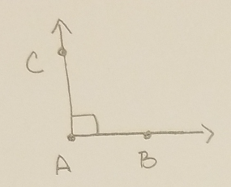
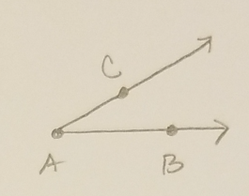
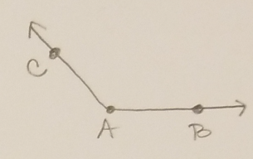
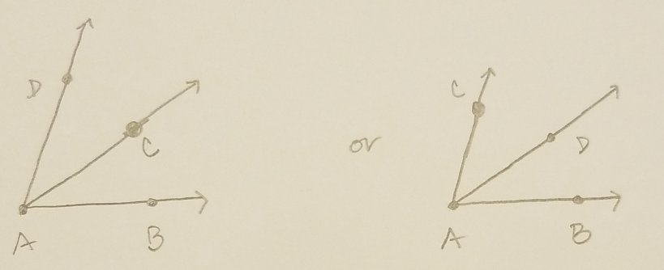
same angle measure
μ(<BAC) = μ(<EDF)
right
acute
obtuse

Slide 4
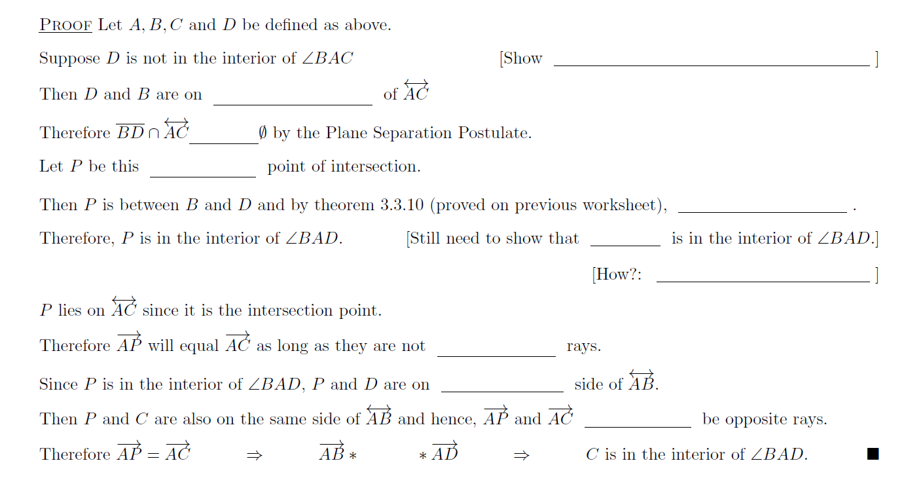
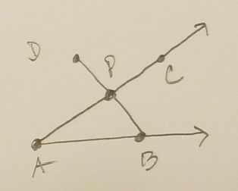
that C is in the interior of <BAD
opposite sides
≠
unique
AB * AP * AD
C
Show that AP = AC
opposite
the same
cannot
AC

Slide 5
Contrapositive:
If D is not in the interior of <BAC, then C is in the interior of <BAD.
Which is what we just proved.

Slide 6
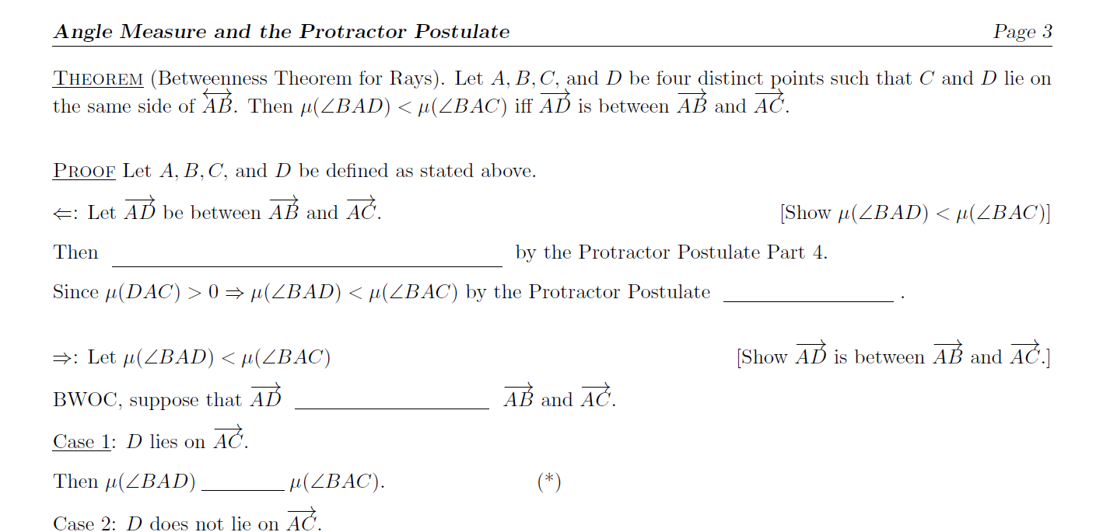
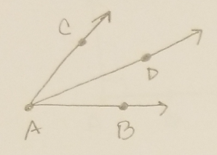
μ(<BAD) + μ(<DAC) = μ(<BAC)
Parts 1 & 2
is not between
=

Slide 7
C
<BAD
AB and AD
μ(<BAC) < μ(<BAD)
≥

Slide 8
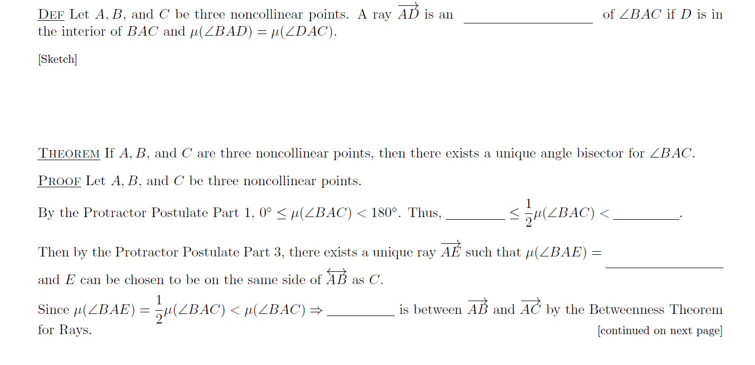
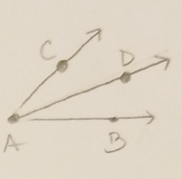
angle bisector
0◦
90◦
½ μ(<BAC)
AE

Slide 9
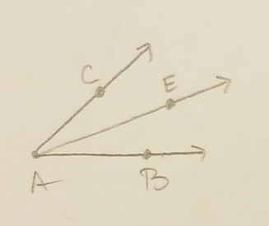
the Protractor Postulate Part 4

Slide 10
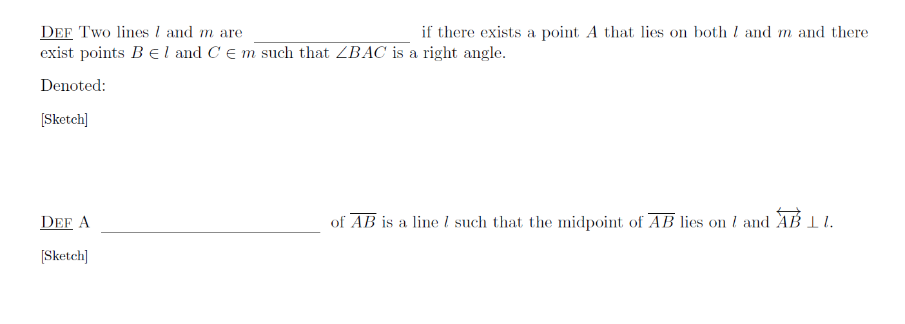
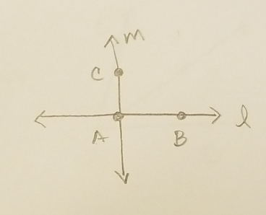
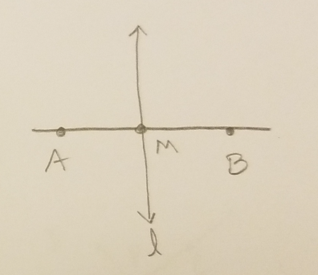
perpendicular
perpendicular bisector

Slide 11
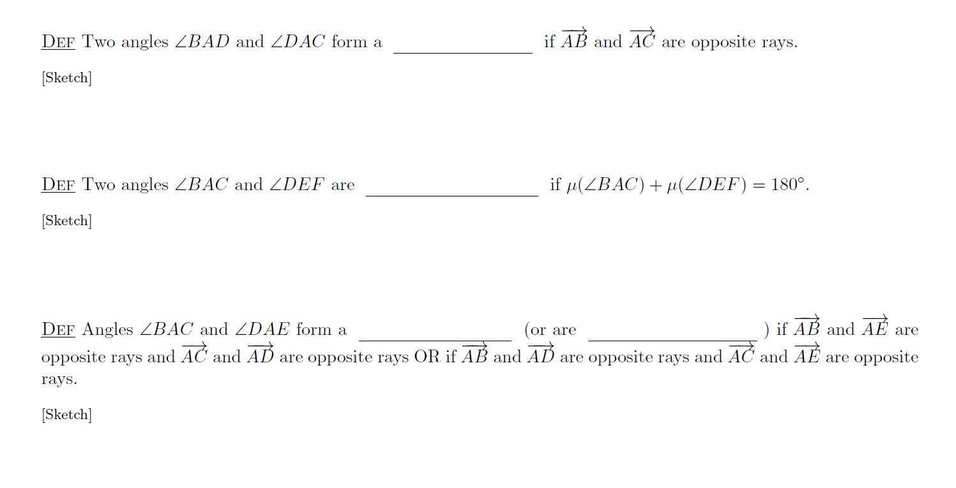
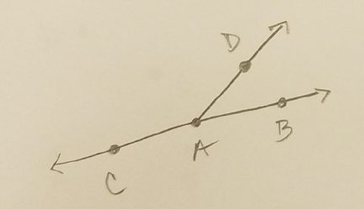
linear pair
supplementary
vertical pair
vertical angles

